Slide 1
Android: Multi-Threading

Slide 2
Multi-Threading
Threads http://developer.android.com/reference/java/lang/Thread.html
A Thread is a concurrent unit of execution.
Each thread has its own call stack. The call stack is used on method calling, parameter passing, and storage for the called method’s local variables.
Each virtual machine instance has at least one main thread .
Threads in the same VM interact and synchronize by the use of shared objects and monitors associated with these objects.
2

Slide 3
Multi-Threading
Process 2 (Dalvik Virtual Machine 2)
Process 1 (Dalvik Virtual Machine 1)
Common memory resources
Common memory resources
Main thread
main thread
Thread-2
Thread-1
3
3

Slide 4
Multi-Threading
Threads http://developer.android.com/reference/java/lang/Thread.html
There are basically two main ways of having a Thread execute application code.
Create a new class that extends Thread and override its run() method.
MyThread t = new MyThread();
t.start();
Create a new Thread instance passing to it a Runnable object.
Runnable myRunnable1 = new MyRunnableClass();
Thread t1 = new Thread(myRunnable1);
t1.start();
In both cases, the start() method must be called to actually execute the new Thread.
4

Slide 5
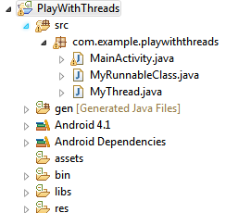
Multi-Threading
Threads http://developer.android.com/reference/java/lang/Thread.html
Example1. Creating two threads using different programming styles.
Main Thread
public class MainActivity extends Activity {
@Override
public void onCreate(Bundle savedInstanceState) {
super.onCreate(savedInstanceState);
setContentView(R.layout.activity_main);
Runnable myRunnable1 = new MyRunnableClass();
Thread t1 = new Thread(myRunnable1);
t1.start();
MyThread t = new MyThread();
t.start();
}//onCreate
5

Slide 6
Multi-Threading
Threads http://developer.android.com/reference/java/lang/Thread.html
Example1. Creating two threads using different programming styles.
MyRunnable Class
public class MyRunnableClass implements Runnable {
@Override
public void run() {
try {
for (int i = 100; i < 105; i++){
Thread.sleep(1000);
Log.e("<<runnable>>", “runnable talking: " + i);
}
} catch (InterruptedException e) {
e.printStackTrace();
}
}//run
}//class
6

Slide 7
Multi-Threading
Threads http://developer.android.com/reference/java/lang/Thread.html
Example1. Creating two threads using different programming styles.
MyThread Class
public class MyThread extends Thread{
@Override
public void run() {
super.run();
try {
for(int i=0; i<5; i++){
Thread.sleep(1000);
Log.e("[[thread]]", "Thread talking: " + i);
}
} catch (InterruptedException e) {
// TODO Auto-generated catch block
e.printStackTrace();
}
}//run
}//class
7

Slide 8

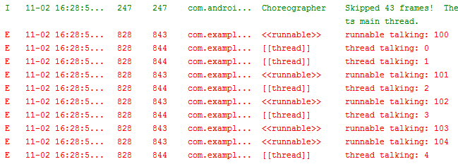
Multi-Threading
Threads http://developer.android.com/reference/java/lang/Thread.html
Example1. Creating two threads using different programming styles.
Interleaved execution
8

Slide 9
Multi-Threading
Advantages of Multi-Threading
Threads share the process' resources but are able to execute independently.
Applications responsibilities can be separated
main thread runs UI, and
slow tasks are sent to background threads.
Threading provides an useful abstraction of concurrent execution.
A multithreaded program operates faster on computer systems that have multiple CPUs.
9

Slide 10
Multi-Threading
A2
A3
A1
Disadvantages of Multi-Threading
Code tends to be more complex
Need to detect, avoid, resolve deadlocks
A1
Waiting for A2 to finish
A2
Waiting for A1 to finish
10

Slide 11
Multi-Threading
Android‘s Approach to Slow Activities
Problem: An application may involve a time-consuming operation.
Goal: We want the UI to be responsive to the user in spite of heavy load.
Solution: Android offers two ways for dealing with this scenario:
Do expensive operations in a background service, using notifications to inform users about next step
Do the slow work in a background thread.
Using Threads: Interaction between Android threads is accomplished using
a main thread Handler object and
posting Runnable objects to the main view.
11

Slide 12
Multi-Threading
Handler Class
http://developer.android.com/reference/android/os/Handler.html
The main thread runs a message queue that takes care of managing the interaction between top-level application objects (activities, intent receivers, etc) and any windows they create.
You can create your own secondary threads, and communicate back with the main application thread through a user-defined Handler.
Your new Handler is bound to the message queue of the thread in which it is created.
The Handler will deliver messages and runnables to that message queue and execute them as they come out of the message queue.
12

Slide 13

Multi-Threading
Main Thread
Handler Class
http://developer.android.com/reference/android/os/Handler.html
There are two main uses for a Handler:
to schedule messages and runnables to be executed as some point in the future; and
to enqueue an action to be performed on another thread
Message Queue
message1
message2
runnable1
message3
runnabl2
Activitty
Receiver
Thread
13

Slide 14

Multi-Threading
Threads and UI
Warning
Background threads are not allowed to interact with the UI.
Only the main process can access the (main) activity’s view.
(Global) class variables can be seen and updated in the threads
14

Slide 15
Multi-Threading
Observation:
Typically the main UI thread sets a handler to get messages from the worker threads; however each worker thread could also define its own handler.
A handler in the worker thread creates a local message-queue which could be used to receive messages from other threads (including main).
Worker1 Thread &
Message Queue
Main Thread &
Message Queue
Worker2 Thread &
Message Queue
15

Slide 16
Multi-Threading
Handler‘s MessageQueue
A secondary thread that wants to communicate with the main thread must request a message token using the obtainMessage() method.
Once obtained, the background thread can fill data into the message token and attach it to the Handler’s message queue using the sendMessage() method.
The Handler uses the handleMessage() method to continuously attend new messages arriving to the main thread.
A message extracted from the process’ queue can either return some data to the main process or request the execution of runnable objects through the post() method.
16

Slide 17
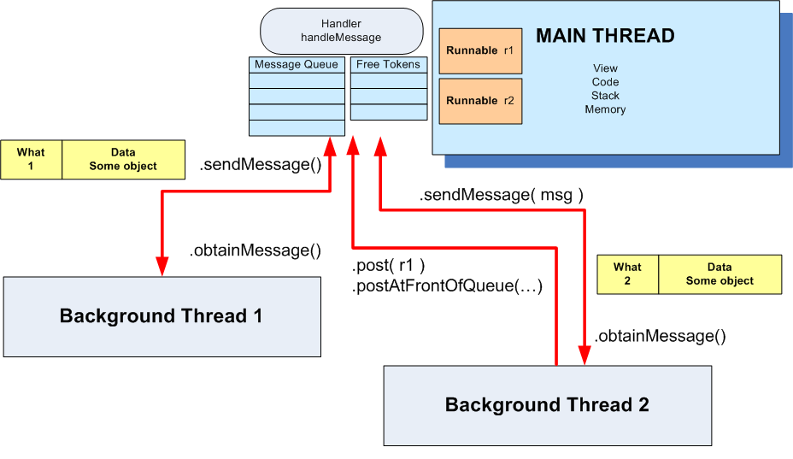
Multi-Threading
17

Slide 18
Multi-Threading
Using Messages
Main Thread | Background Thread
... Handler myHandler = new Handler() { @Override public void handleMessage(Message msg) { // do something with the message... // update GUI if needed! ... }//handleMessage };//myHandler ... | ... Thread backgJob = new Thread (new Runnable (){ @Override public void run() { //...do some busy work here ... //get a token to be added to //the main's message queue Message msg = myHandler.obtainMessage(); ... //deliver message to the //main's message-queue myHandler.sendMessage(msg); }//run });//Thread //this call executes the parallel thread backgroundJob.start(); ...
v
18

Slide 19
Multi-Threading
Using Post
Main Thread | Background Thread
... Handler myHandler = new Handler(); @Override public void onCreate( Bundle savedInstanceState) { ... Thread myThread1 = new Thread(backgroundTask, "backAlias1"); myThread1.start(); }//onCreate ... //this is the foreground runnable private Runnable foregroundTask = new Runnable() { @Override public void run() { // work on the UI if needed } ... | // this is the "Runnable" object // that executes the background thread private Runnable backgroundTask = new Runnable () { @Override public void run() { ... Do some background work here myHandler.post(foregroundTask); }//run };//backgroundTask
19

Slide 20
Multi-Threading
Messages
To send a Message to a Handler, the thread must first invoke obtainMessage() to get the Message object out of the pool.
There are a few forms of obtainMessage(), allowing you to just create an empty Message object, or messages holding arguments
Example
// thread 1 produces some local data
String localData = “Greetings from thread 1”;
// thread 1 requests a message & adds localData to it
Message mgs = myHandler.obtainMessage (1, localData);
20
20

Slide 21
Multi-Threading
sendMessage Methods
You deliver the message using one of the sendMessage...() family of methods, such as …
• sendMessage() puts the message at the end of the queue immediately
• sendMessageAtFrontOfQueue() puts the message at the front of the queue
immediately (versus the back, as is the default), so your message takes
priority over all others
• sendMessageAtTime() puts the message on the queue at the stated
time, expressed in the form of milliseconds based on system uptime
(SystemClock.uptimeMillis())
• sendMessageDelayed() puts the message on the queue after a delay,
expressed in milliseconds
21
21

Slide 22
Multi-Threading
Processing Messages
To process messages sent by the background threads, your Handler needs to implement the listener
handleMessage( Message msg )
which will be called with each message (msg) that appears on the message queue.
There, the handler can update the UI as needed. However, it should still do that work quickly, as other UI work is suspended until the Handler is done.
22
22

Slide 23
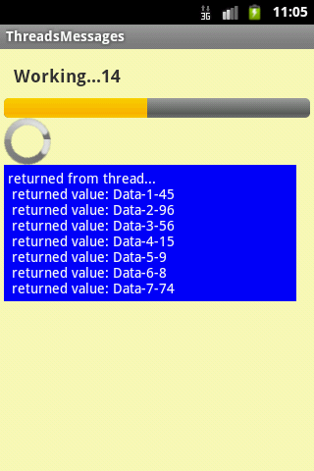
Multi-Threading
Example 2. Progress Bar – Using Message Passing Layout 1/2
The main thread displays a horizontal and a circular progress bar widget showing the progress of a slow background operation. Some random data is periodically sent from the background thread and the messages are displayed in the main view.
<?xml version="1.0" encoding="utf-8"?>
<LinearLayout xmlns:android="http://schemas.android.com/apk/res/android"
android:layout_width="match_parent"
android:layout_height="match_parent"
android:background="#44ffff00"
android:orientation="vertical"
android:padding="4dp" >
<TextView
android:id="@+id/txtWorkProgress"
android:layout_width="match_parent"
android:layout_height="wrap_content"
android:padding="10dp"
android:text="Working ...."
android:textSize="18sp"
android:textStyle="bold" />
<ProgressBar
android:id="@+id/progress1"
style="?android:attr/progressBarStyleHorizontal"
android:layout_width="match_parent"
android:layout_height="wrap_content" />
<ProgressBar
android:id="@+id/progress2"
android:layout_width="wrap_content"
android:layout_height="wrap_content" />
23
23
23

Slide 24
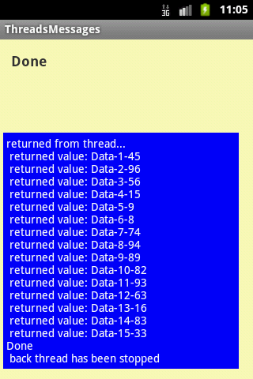
Multi-Threading
Example 2. Progress Bar – Using Message Passing Layout 2/2
The main thread displays a horizontal and a circular progress bar widget showing the progress of a slow background operation. Some random data is periodically sent from the background thread and the messages are displayed in the main view.
<ScrollView
android:layout_width="match_parent"
android:layout_height="wrap_content" >
<TextView
android:id="@+id/txtReturnedValues"
android:layout_width="match_parent"
android:layout_height="wrap_content"
android:layout_margin="7dp"
android:background="#ff0000ff"
android:padding="4dp "
android:text="returned from thread..."
android:textColor="@android:color/white"
android:textSize="14sp" />
</ScrollView>
</LinearLayout>
24
24
24

Slide 25
Multi-Threading
Example 2. Progress Bar – Using Message Passing Activity 1/5
The main thread displays a horizontal and a circular progress bar widget showing the progress of a slow background operation. Some random data is periodically sent from the background thread and the messages are displayed in the main view.
public class ThreadsMessages extends Activity {
ProgressBar bar1;
ProgressBar bar2;
TextView msgWorking;
TextView msgReturned;
// this is a control var used by backg. threads
boolean isRunning = false;
// lifetime (in seconds) for background thread
final int MAX_SEC = 30;
//String globalStrTest = "global value seen by all threads ";
int globalIntTest = 0;
25
25
25

Slide 26
Multi-Threading
Example 2. Progress Bar – Using Message Passing Activity 2/5
Handler handler = new Handler() {
@Override
public void handleMessage(Message msg) {
String returnedValue = (String)msg.obj;
//do something with the value sent by the background thread here
msgReturned.append("\n returned value: " + returnedValue );
bar1.incrementProgressBy(2);
//testing early termination
if (bar1.getProgress() == MAX_SEC){
msgReturned.append(" \nDone \n back thread has been stopped");
isRunning = false;
}
if (bar1.getProgress() == bar1.getMax()){
msgWorking.setText("Done");
bar1.setVisibility(View.INVISIBLE);
bar2.setVisibility(View.INVISIBLE);
}
else {
msgWorking.setText("Working..." + bar1.getProgress() );
}
}
}; //handler
26
26
26

Slide 27
Multi-Threading
Example 2. Progress Bar – Using Message Passing Activity 3/5
@Override
public void onCreate(Bundle icicle) {
super.onCreate(icicle);
setContentView(R.layout.main);
bar1 = (ProgressBar) findViewById(R.id.progress1);
bar1.setProgress(0);
bar1.setMax(MAX_SEC);
bar2 = (ProgressBar) findViewById(R.id.progress2);
msgWorking = (TextView)findViewById(R.id.txtWorkProgress);
msgReturned = (TextView)findViewById(R.id.txtReturnedValues);
//globalStrTest += "XXX"; // slightly change the global string
globalIntTest = 1;
}//onCreate
27
27
27

Slide 28
Multi-Threading
Example 2. Progress Bar – Using Message Passing Activity 4/5
public void onStart() {
super.onStart();
// this code creates the background activity where busy work is done
Thread background = new Thread(new Runnable() {
public void run() {
try {
for (int i = 0; i < MAX_SEC && isRunning; i++) {
//try a Toast method here (it will not work!)
//fake busy busy work here
Thread.sleep(1000); //one second at a time
// this is a locally generated value between 0-100
Random rnd = new Random();
int localData = (int) rnd.nextInt(101);
//we can see and change (global) class variables
String data = "Data-" + globalIntTest + "-" + localData;
globalIntTest++;
//request a message token and put some data in it
Message msg = handler.obtainMessage(1, (String)data);
// if thread is still alive send the message
if (isRunning) {
handler.sendMessage(msg);
}
}
}
28
28
28

Slide 29
Multi-Threading
Example 2. Progress Bar – Using Message Passing Activity 5/5
catch (Throwable t) {
// just end the background thread
isRunning = false;
}
}
});// Tread
isRunning = true;
background.start();
}//onStart
public void onStop() {
super.onStop();
isRunning = false;
}//onStop
}//class
29
29
29

Slide 30
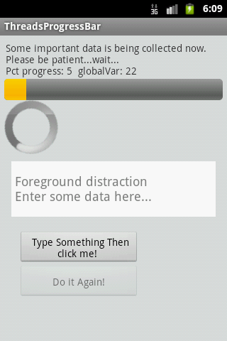
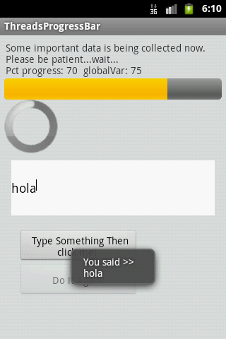
Multi-Threading
Example 3. Using Handler post(...) Method
We will try the same problem presented earlier (a slow background task and a responsive foreground UI) this time using the posting mechanism to execute foreground runnables.
30
Images obtained from a GingerBread based emulator
30

Slide 31
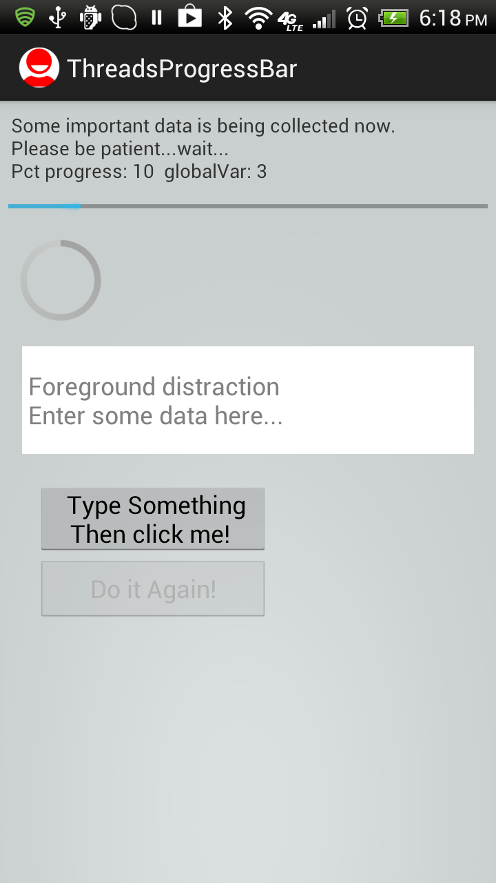
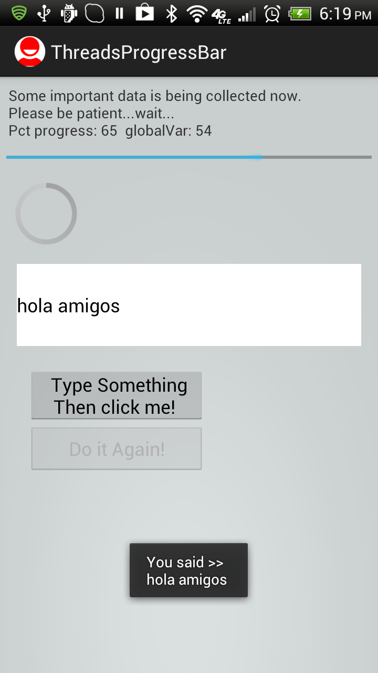
Multi-Threading
Example 3. Using Handler post(...) Method
We will try the same problem presented earlier (a slow background task and a responsive foreground UI) this time using the posting mechanism to execute foreground runnables.
31
31
Images obtained from an IceCream 4.x based device

Slide 32
Multi-Threading
Example 3. Using post - layout: main.xml
<?xml version="1.0" encoding="utf-8"?>
<LinearLayout xmlns:android="http://schemas.android.com/apk/res/android"
android:layout_width="match_parent"
android:layout_height="match_parent"
android:background="#22002222"
android:orientation="vertical"
android:padding="6dp" >
<TextView
android:id="@+id/lblTopCaption"
android:layout_width="match_parent"
android:layout_height="wrap_content"
android:padding="2dp"
android:text=
"Some important data is been collected now. Patience please..." />
<ProgressBar
android:id="@+id/myBarHor"
style="?android:attr/progressBarStyleHorizontal"
android:layout_width="match_parent"
android:layout_height="30dp" />
<ProgressBar
android:id="@+id/myBarCir"
style="?android:attr/progressBarStyleLarge"
android:layout_width="wrap_content"
android:layout_height="wrap_content" />
32
32

Slide 33
Multi-Threading
Example 3. Using post - layout: main.xml
<EditText
android:id="@+id/txtBox1"
android:layout_width="match_parent"
android:layout_height="78dp"
android:layout_margin="10dp"
android:background="#ffffffff"
android:textSize="18sp" />
<Button
android:id="@+id/btnDoSomething"
android:layout_width="170dp"
android:layout_height="wrap_content"
android:layout_marginLeft="20dp"
android:layout_marginTop="10dp"
android:padding="4dp"
android:text=" Type Something Then click me! " />
<Button
android:id="@+id/btnDoItAgain"
android:layout_width="170dp"
android:layout_height="wrap_content"
android:layout_marginLeft="20dp"
android:padding="4dp"
android:text=" Do it Again! " />
</LinearLayout>
33
33

Slide 34
Multi-Threading
Example 3. Using post - Main Activity 1/5
public class ThreadsPosting extends Activity {
ProgressBar myBarHorizontal;
ProgressBar myBarCircular;
TextView lblTopCaption;
EditText txtDataBox;
Button btnDoSomething;
Button btnDoItAgain;
int progressStep = 5;
int globalVar = 0;
int accum = 0;
long startingMills = System.currentTimeMillis();
boolean isRunning = false;
String PATIENCE = "Some important data is being collected now. "
+ "\nPlease be patient...wait... ";
Handler myHandler = new Handler();
@Override
public void onCreate(Bundle savedInstanceState) {
super.onCreate(savedInstanceState);
setContentView(R.layout.main);
lblTopCaption = (TextView) indViewById(R.id.lblTopCaption);
34
34

Slide 35
Multi-Threading
Example 3. Using post - Main Activity 2/5
myBarHorizontal = (ProgressBar) findViewById(R.id.myBarHor);
myBarCircular = (ProgressBar) findViewById(R.id.myBarCir);
txtDataBox = (EditText) findViewById(R.id.txtBox1);
txtDataBox.setHint(" Foreground distraction\n Enter some data here...");
btnDoItAgain = (Button) findViewById(R.id.btnDoItAgain);
btnDoItAgain.setOnClickListener(new OnClickListener() {
@Override
public void onClick(View v) {
onStart();
}// onClick
});// setOnClickListener
btnDoSomething = (Button) findViewById(R.id.btnDoSomething);
btnDoSomething.setOnClickListener(new OnClickListener() {
@Override
public void onClick(View v) {
Editable text = txtDataBox.getText();
Toast.makeText(getBaseContext(), "You said >> \n" + text, 1).show();
}// onClick
});// setOnClickListener
}// onCreate
35
35

Slide 36
Multi-Threading
Example 3. Using post - Main Activity 3/5
@Override
protected void onStart() {
super.onStart();
// prepare UI components
txtDataBox.setText("");
btnDoItAgain.setEnabled(false);
// reset and show progress bars
accum = 0;
myBarHorizontal.setMax(100);
myBarHorizontal.setProgress(0);
myBarHorizontal.setVisibility(View.VISIBLE);
myBarCircular.setVisibility(View.VISIBLE);
// create background thread were the busy work will be done
Thread myBackgroundThread = new Thread( backgroundTask, "backAlias1" );
myBackgroundThread.start();
}
36
36

Slide 37
Multi-Threading
Example 3. Using post - Main Activity 3/5
@Override
protected void onStart() {
super.onStart();
// prepare UI components
txtDataBox.setText("");
btnDoItAgain.setEnabled(false);
// reset and show progress bars
accum = 0;
myBarHorizontal.setMax(100);
myBarHorizontal.setProgress(0);
myBarHorizontal.setVisibility(View.VISIBLE);
myBarCircular.setVisibility(View.VISIBLE);
// create background thread were the busy work will be done
Thread myBackgroundThread = new Thread( backgroundTask, "backAlias1" );
myBackgroundThread.start();
}
37
37

Slide 38
Multi-Threading
Example 3. Using post - Main Activity 4/5
// FOREGROUND
// this foreground Runnable works on behave of the background thread
// updating the main UI which is unreachable to it
private Runnable foregroundRunnable = new Runnable() {
@Override
public void run() {
try {
// update UI, observe globalVar is changed in back thread
lblTopCaption.setText( PATIENCE
+ "\nPct progress: " + accum
+ " globalVar: " + globalVar);
// advance ProgressBar
myBarHorizontal.incrementProgressBy(progressStep);
accum += progressStep;
// are we done yet?
if (accum >= myBarHorizontal.getMax()) {
lblTopCaption.setText("Background work is OVER!");
myBarHorizontal.setVisibility(View.INVISIBLE);
myBarCircular.setVisibility(View.INVISIBLE);
btnDoItAgain.setEnabled(true);
}
} catch (Exception e) {
Log.e("<<foregroundTask>>", e.getMessage());
}
}
}; // foregroundTask
Foreground runnable is defined but not started !
Background thread will requests its execution later
38
38

Slide 39
Multi-Threading
Example 3. Using post - Main Activity 5/5
// BACKGROUND
// this is the back runnable that executes the slow work
private Runnable backgroundTask = new Runnable() {
@Override
public void run() {
// busy work goes here...
try {
for (int n = 0; n < 20; n++) {
// this simulates 1 sec. of busy activity
Thread.sleep(1000);
// change a global variable from here...
globalVar++;
// try: next two UI operations should NOT work
// Toast.makeText(getApplication(), "Hi ", 1).show();
// txtDataBox.setText("Hi ");
// wake up foregroundRunnable delegate to speak for you
myHandler.post(foregroundRunnable);
}
} catch (InterruptedException e) {
Log.e("<<foregroundTask>>", e.getMessage());
}
}// run
};// backgroundTask
}// ThreadsPosting
Tell foreground runnable to do something for us…
39
39

Slide 40
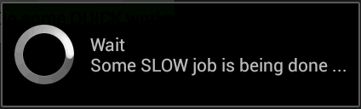
Multi-Threading
Using the AsyncTask class
The AsyncTask class allows to perform background operations and publish results on the UI thread without having to manipulate threads and/or handlers.
An asynchronous task is defined by a computation that runs on a background thread and whose result is published on the UI thread.
An asynchronous task is defined by
3 Generic Types | 4 Main States | 1 Auxiliary Method
Params, Progress, Result | onPreExecute, doInBackground, onProgressUpdate onPostExecute. | publishProgress
40
40
40

Slide 41
Multi-Threading
AsyncTask <Params, Progress, Result>
AsyncTask's generic types
Params: the type of the input parameters sent to the task at execution.
Progress: the type of the progress units published during the background computation.
Result: the type of the result of the background computation.
Not all types are always used by an asynchronous task. To mark a type as unused, simply use the type Void
Note:
Syntax “String ...” indicates (Varargs) array of String values, similar to “String[]”
41
41
41

Slide 42
Multi-Threading
Using the AsyncTask class
private class VerySlowTask extends AsyncTask<String, Long, Void> {
// Begin - can use UI thread here
protected void onPreExecute() {
}
// this is the SLOW background thread taking care of heavy tasks
// cannot directly change UI
protected Void doInBackground(final String... args) {
... publishProgress((Long) someLongValue);
}
// periodic updates - it is OK to change UI
@Override
protected void onProgressUpdate(Long... value) {
}
// End - can use UI thread here
protected void onPostExecute(final Void unused) {
}
}
1
2
3
4
42
42
42
42
42
42
42

Slide 43
Multi-Threading
AsyncTask's methods
onPreExecute(), invoked on the UI thread immediately after the task is executed. This step is normally used to setup the task, for instance by showing a progress bar in the user interface.
doInBackground(Params...), invoked on the background thread immediately after onPreExecute() finishes executing. This step is used to perform background computation that can take a long time. The parameters of the asynchronous task are passed to this step. The result of the computation must be returned by this step and will be passed back to the last step. This step can also use publishProgress(Progress...) to publish one or more units of progress. These values are published on the UI thread, in the onProgressUpdate(Progress...) step.
onProgressUpdate(Progress...), invoked on the UI thread after a call to publishProgress(Progress...). The timing of the execution is undefined. This method is used to display any form of progress in the user interface while the background computation is still executing. For instance, it can be used to animate a progress bar or show logs in a text field.
onPostExecute(Result), invoked on the UI thread after the background computation finishes. The result of the background computation is passed to this step as a parameter.
43
43
43

Slide 44
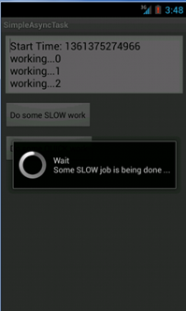
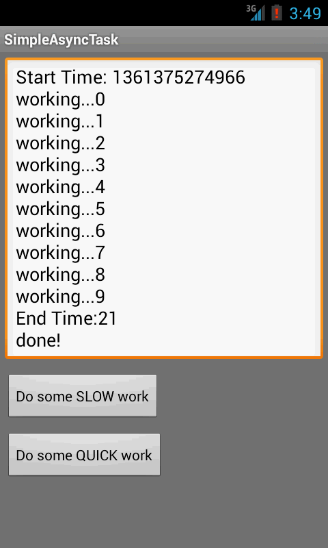
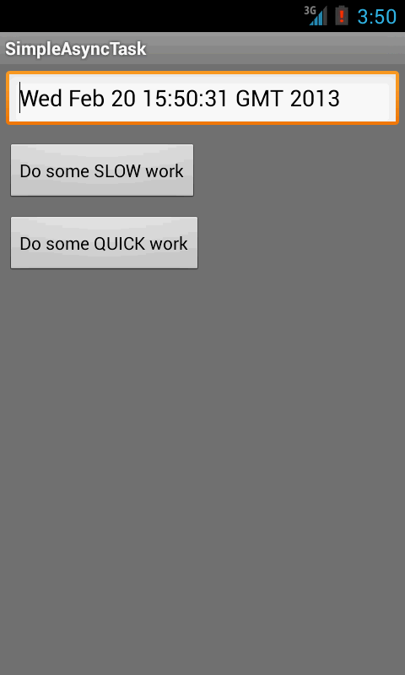
Multi-Threading
Example 4: Using the AsyncTask class
The main task invokes an AsyncTask to do some slow job. The AsyncTask methods do the required computation and periodically update the main’s UI. In our the example the background activity negotiates the writing of the lines in the text box, and also controls the circular progress bar.
44
44
44
44

Slide 45
Multi-Threading
Example 4: Using the AsyncTask class
public class Main extends Activity {
Button btnSlowWork;
Button btnQuickWork;
EditText txtMsg;
Long startingMillis;
@Override
public void onCreate(Bundle savedInstanceState) {
super.onCreate(savedInstanceState);
setContentView(R.layout.main);
txtMsg = (EditText) findViewById(R.id.EditText01);
// slow work...for example: delete all data from a database
btnSlowWork = (Button) findViewById(R.id.Button01);
this.btnSlowWork.setOnClickListener(new OnClickListener() {
public void onClick(final View v) {
new VerySlowTask().execute();
}
});
btnQuickWork = (Button) findViewById(R.id.Button02);
// delete all data from database (when delete button is clicked)
this.btnQuickWork.setOnClickListener(new OnClickListener() {
public void onClick(final View v) {
txtMsg.setText((new Date()).toString());
}
});
}// onCreate
45
45
45
45

Slide 46
Multi-Threading
Example 4: Using the AsyncTask class
private class VerySlowTask extends AsyncTask <String, Long, Void> {
private final ProgressDialog dialog = new ProgressDialog(Main.this);
// can use UI thread here
protected void onPreExecute() {
startingMillis = System.currentTimeMillis();
txtMsg.setText("Start Time: " + startingMillis);
this.dialog.setMessage("Wait\nSome SLOW job is being done...");
this.dialog.show();
}
// automatically done on worker thread (separate from UI thread)
protected Void doInBackground(final String... args) {
try {
// simulate here the slow activity
for (Long i = 0L; i < 3L; i++) {
Thread.sleep(2000);
publishProgress((Long)i);
}
} catch (InterruptedException e) {
Log.v("slow-job interrupted", e.getMessage())
}
return null;
}
46
46
46
46

Slide 47
Multi-Threading
Example 4: Using the AsyncTask class
// periodic updates - it is OK to change UI
@Override
protected void onProgressUpdate(Long... value) {
super.onProgressUpdate(value);
txtMsg.append("\nworking..." + value[0]);
}
// can use UI thread here
protected void onPostExecute(final Void unused) {
if (this.dialog.isShowing()) {
this.dialog.dismiss();
}
// cleaning-up, all done
txtMsg.append("\nEnd Time:"
+ (System.currentTimeMillis()-startingMillis)/1000);
txtMsg.append("\ndone!");
}
}//AsyncTask
}// Main
47
47
47
47

Slide 48
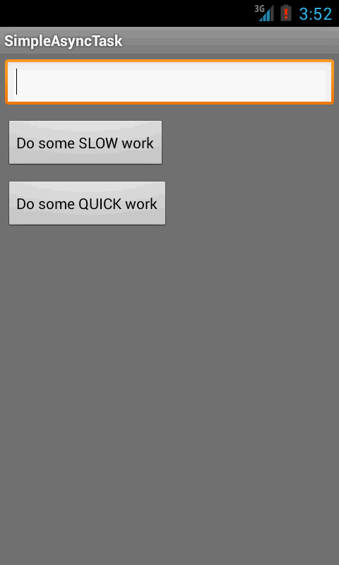
Multi-Threading
Example 4: Using the AsyncTask class
<?xml version="1.0" encoding="utf-8"?>
<LinearLayout xmlns:android="http://schemas.android.com/apk/res/android"
android:layout_width="fill_parent"
android:layout_height="fill_parent"
android:orientation="vertical" >
<EditText
android:id="@+id/EditText01"
android:layout_width="match_parent"
android:layout_height="wrap_content"
android:layout_margin="7dp" />
<Button
android:id="@+id/Button01"
android:layout_width="wrap_content"
android:layout_height="wrap_content"
android:layout_margin="7dp"
android:text="Do some SLOW work" />
<Button
android:id="@+id/Button02"
android:layout_width="wrap_content"
android:layout_height="wrap_content"
android:layout_margin="7dp"
android:text="Do some QUICK work" />
</LinearLayout>
48
48
48
48

Slide 49
Multi-Threading
Questions
49
49

